Slide 1

Master Keyboard Tricks: Most Useful Win Key Shortcuts

Slide 2
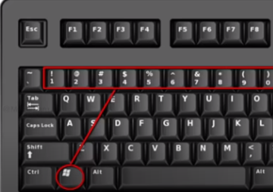
Most Useful Win Key Shortcuts
1. Win Key + 1,2,3,4,5,6,7,8,9 (Program Opening)
2. Win + Up Arrow , Down Arrow
Program Left Side Movement (Left Arrow Key)
Program Right Side Movement (Right Arrow Key)
3. Win +A (Notification Bar)
4. Win + D (Minimize All Opened Programs)

Slide 3
Win Key Shortcuts
5. Win + E (Explorer)
6. Win + Tab & alt + Tab
7. Win + P (Projector Settings)
8. Win + R (Calc,winword, excel, powerpoint)
9. Win + (Magnifier)
10. Win + X (Start Button Right Click Options)
11. Win +L (Login)

